Slide 1
Human Activity Recognition using Optical Flow based Feature Set
S.Santhosh Kumar and Mala John Department of Electronics Engineering,
Madras Institute of Technology, Anna University, Chennai, India

Slide 2
DATASET: weiZmann
We collected a database of 90 low-resolution (180 x 144, deinterlaced 50 fps) video sequences showing 9 different people, each performing 10 natural actions
such as �run,� �walk,� �skip,� �jumping-jack� (or shortly �jack�), �jump-forward-on-two-legs� (or �jump�), �jump-in-place-on-two-legs� (or �pjump�),
�gallopsideways� (or �side�), �wave-two-hands� (or �wave2�), �waveone- hand� (or �wave1�), or �bend.�

Slide 3
dataset: KTH
Action Database
The current video database containing six types of human actions (walking, jogging, running, boxing, hand waving and hand clapping) performed several times
by 25 subjects in four different scenarios: outdoors s1, outdoors with scale variation s2, outdoors with different clothes s3 and indoors s4 as illustrated below.
Currently the database contains 2391 sequences. All sequences were taken over homogeneous backgrounds with a static camera with 25fps frame rate.
The sequences were downsampled to the spatial resolution of 160x120 pixels and have a length of four seconds in average.

Slide 4
propose
Weizmann, KTH, UT interaction set_1 & _2
We propose a local descriptor built by optical flow vectors along the edges of the action performer(s). By using the proposed feature descriptor with multi-class SVM classifier, recognition rates as high as 95.69% and 94.62% have been achieved for Weizmann action dataset and KTH action dataset respectively. The recognition rate achieved is 92.7% for UT interaction Set_1, 90.21% for UT interaction Set_2. The results demonstrate that the method is simple and efficient.

Slide 5
steps:
In this paper, we have proposed a novel, optical flow based feature extraction process. Optical flow feature set is used to represent the segmented object(s). The optical flow based feature vectors are computed along the boundary and the feature set incorporates the shape and instantaneous velocity information extracted along the boundaries of the action performers
The extracted optical flow based features are fed to a classifier. Classification algorithm working on the proposed feature set is the widely used multi-class SVM

Slide 6
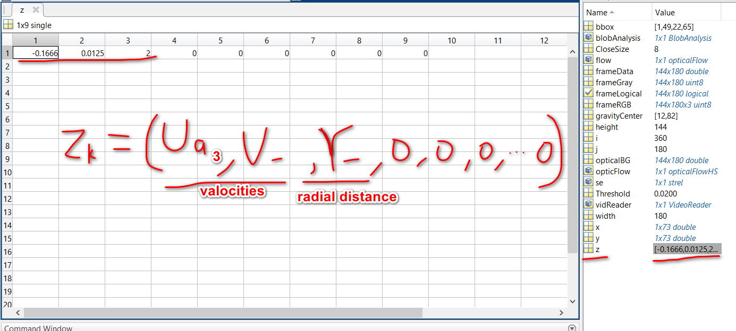
features:
L*S = 648
L is the sequence vide
S is 360/5k=72 radial distance of boundary points and maxmum of 3 such edge points staring from the innermost edge for human actions.
Zk=3*(radial(R)+(u,v))=9

Slide 7
classification
1.read features_data
generate training set and test set randomly
normalization data
train svm (RBF kernel function )
predict to test

Slide 8
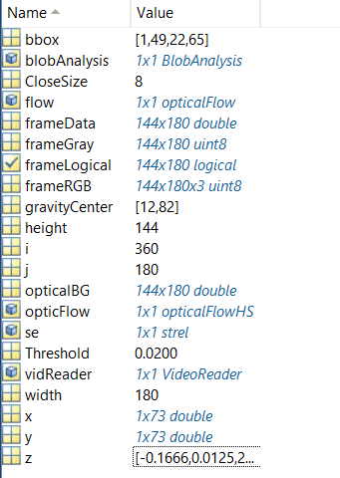
workspace:

Slide 9
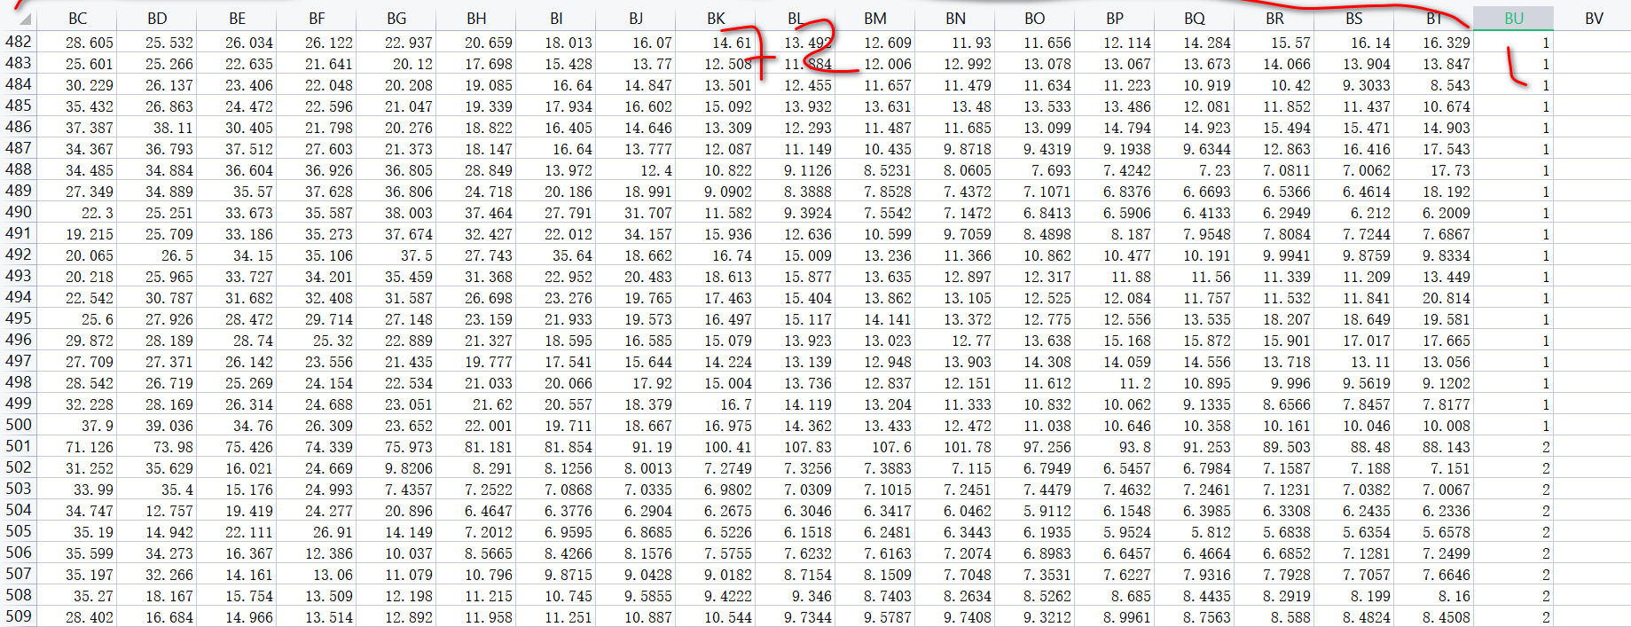
update :15/08/2021
1. features : 72 radial distance of frames
train set : 10 walking features set and 1 jumping features set .

Slide 10
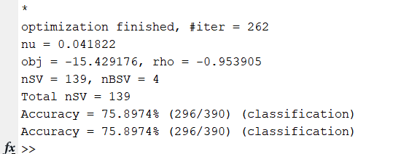
result :

Slide 11
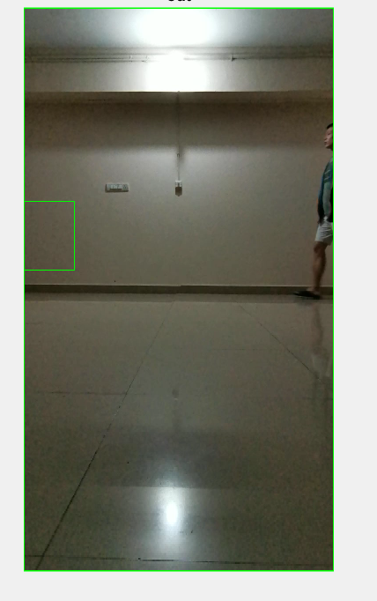
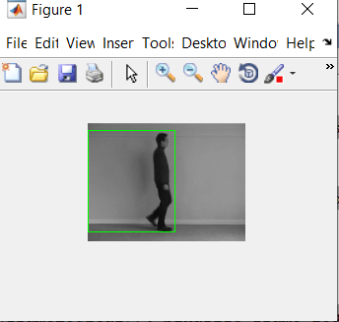
weakness :

Slide 12
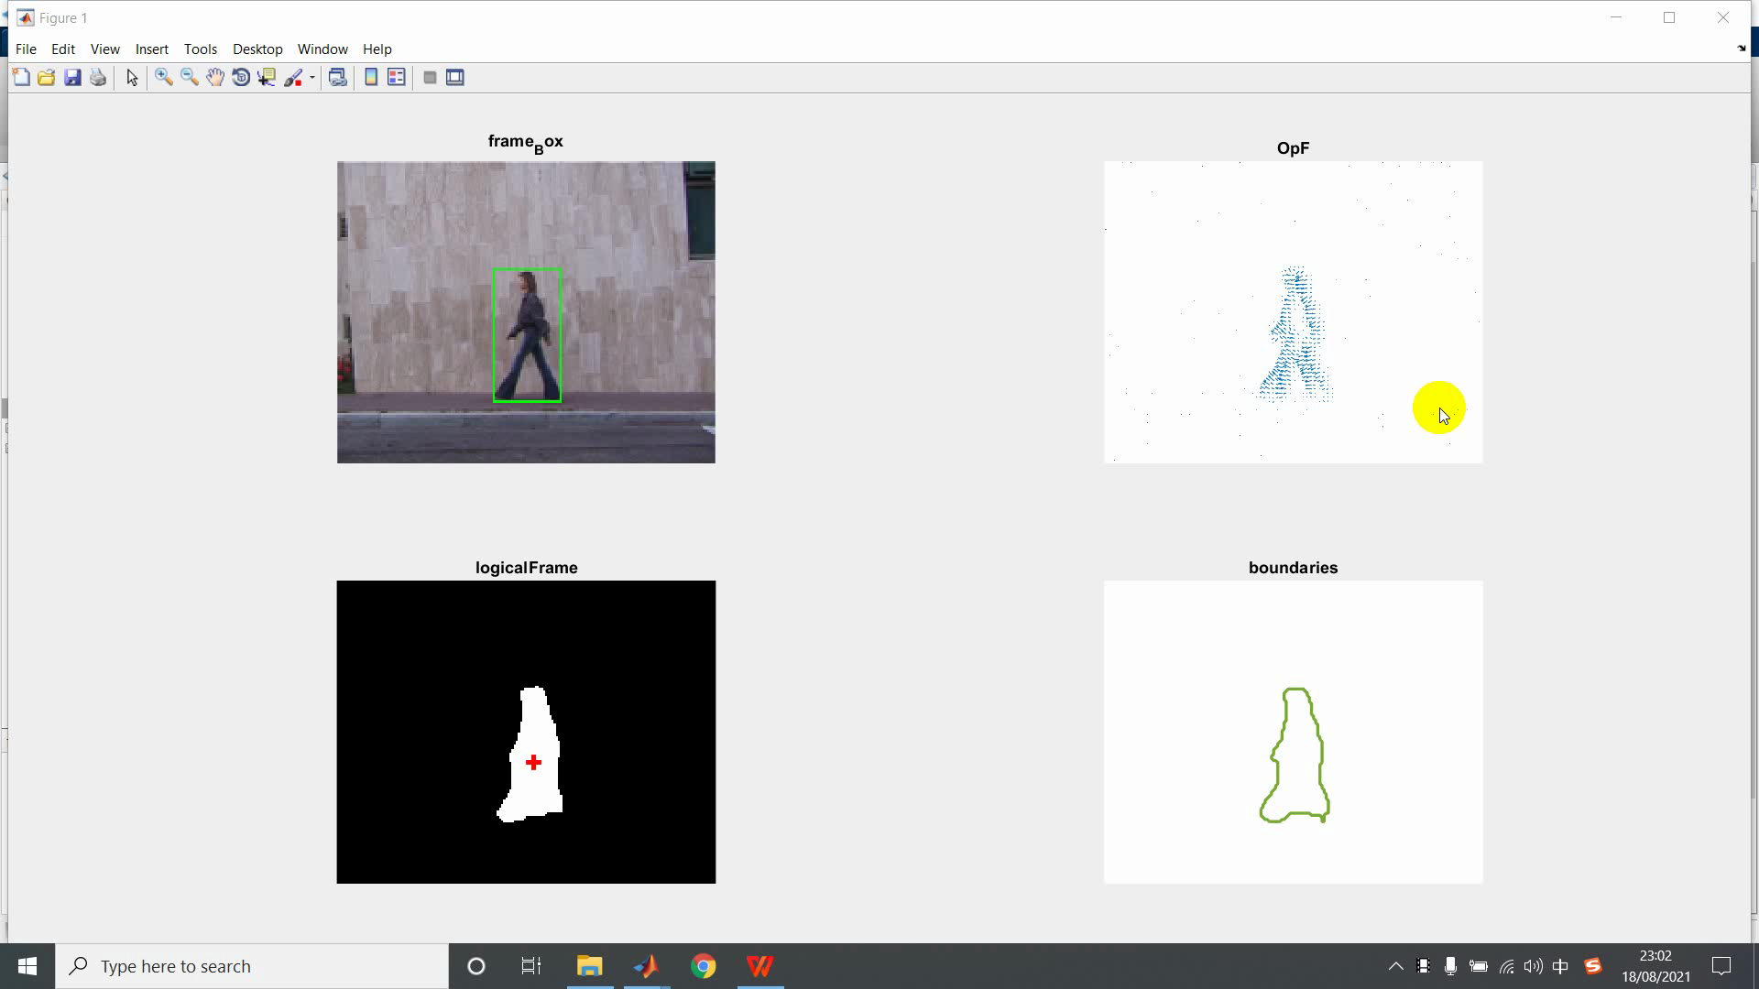
weizmann video

Slide 13
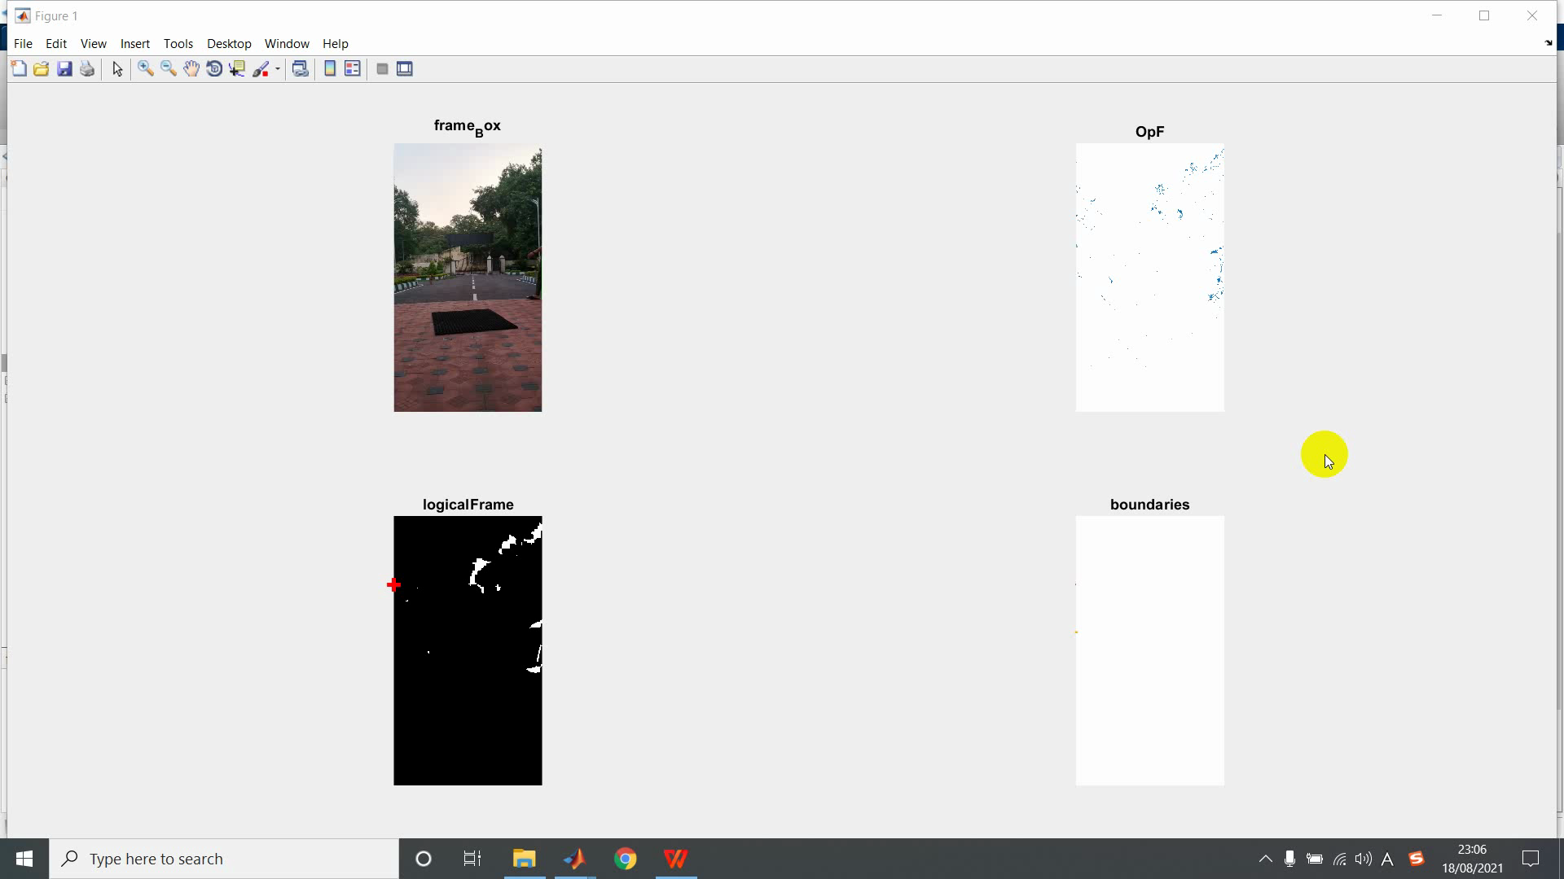
myselt_video

Slide 14
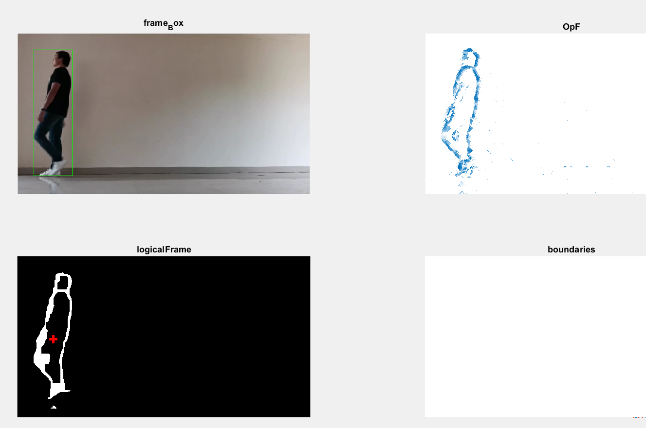

Slide 15
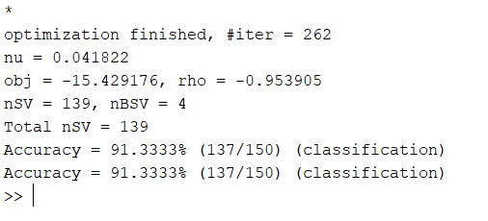
self_video result

Slide 16
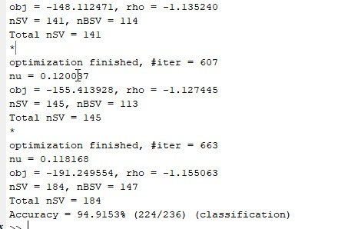
update 10/09/2021

Slide 17
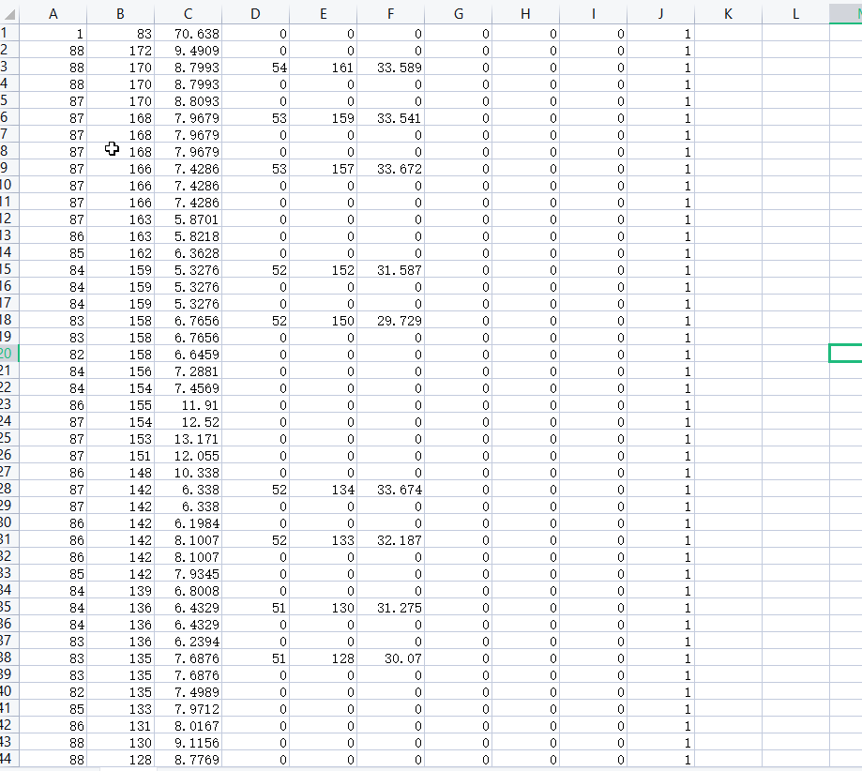
train_features

Slide 18
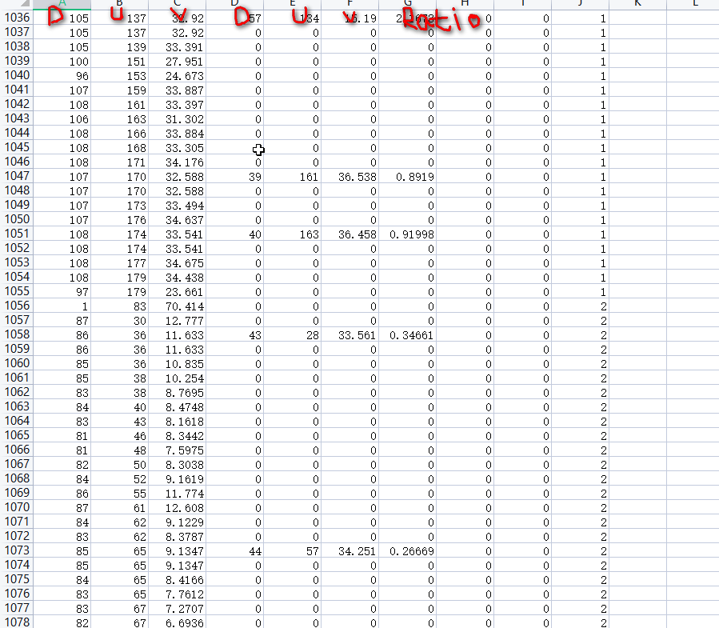
radio distance + u,v+intersection_ratio

Slide 19
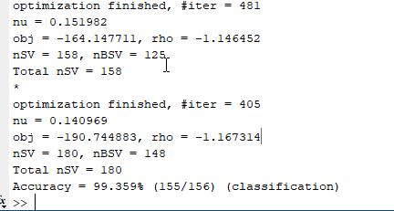
ratio_accuration shahar_walk as test sample.

Slide 20
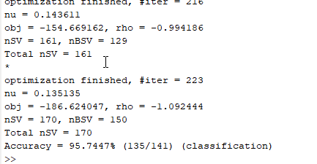
daria_walk as test sample.

Slide 21
features: (dis+u,v)+ratio 1
train_sample(walk+jump) | test_sample(walk) | recognition_rate(%) | remarks
(without shahar)+daria_jump | shahar_walk | 99.359%
(without daria_walk)+daria_jump | daria_walk | 95.7447%
 | eli | 96.7213%
 | ido | 100%
 | ira | 94.0767%
 | lena1 | 100%
 | lena2 | 100%
 | lyova | 100% (328/328)
 | moshe | 100% (72/72)
 | shahar | 98.7179% (154/156)

Slide 22
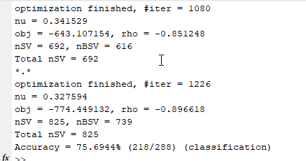
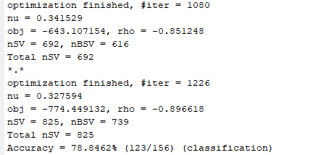
LOO (2) n-1 (walk,jump)trainset. test are shahar

Slide 23
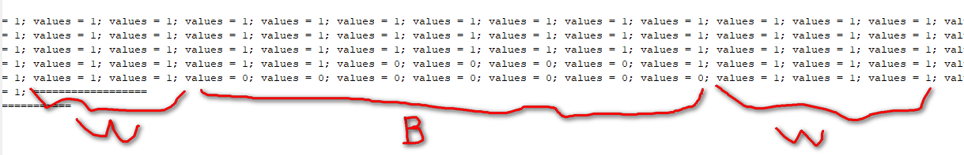
intersection of one line

Slide 24
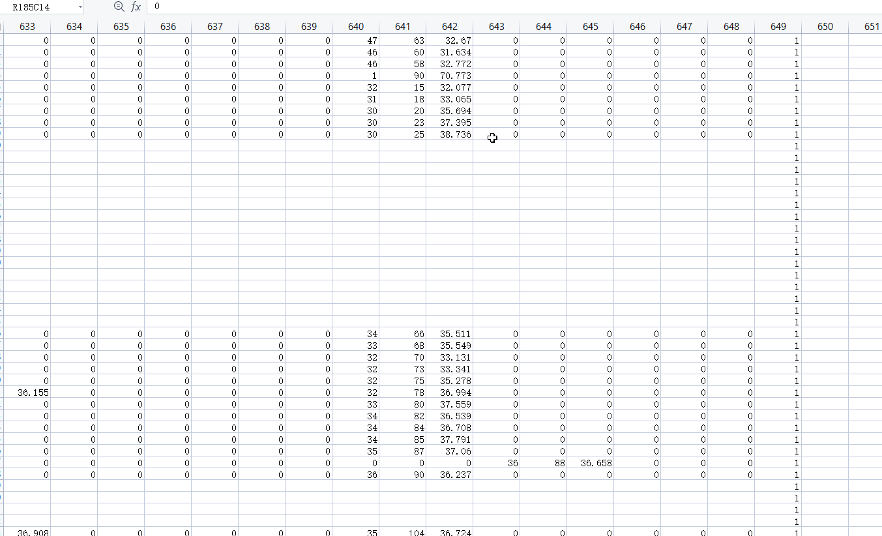
features

Slide 25

values of a frame

